Slide 1
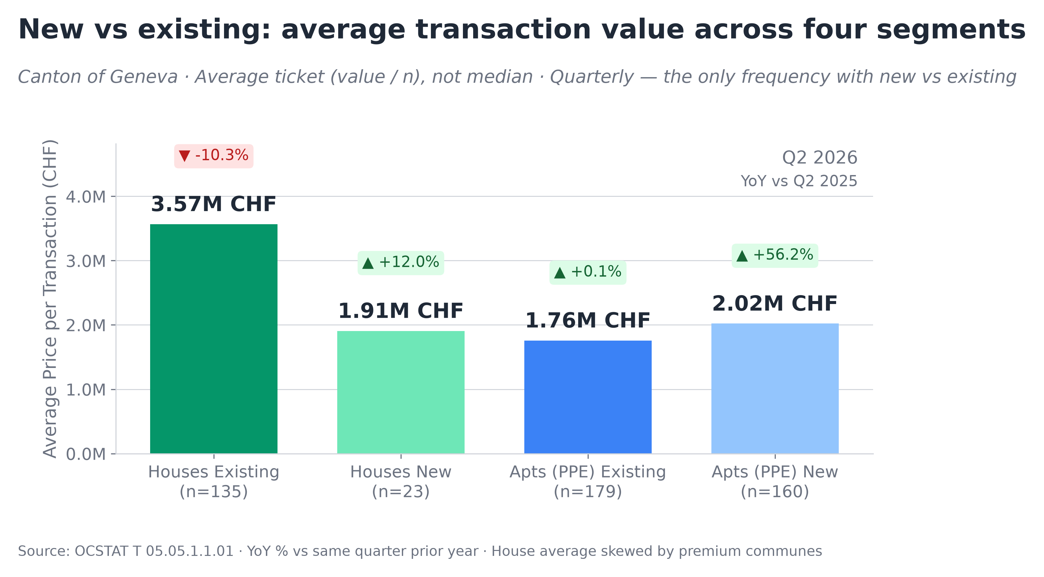
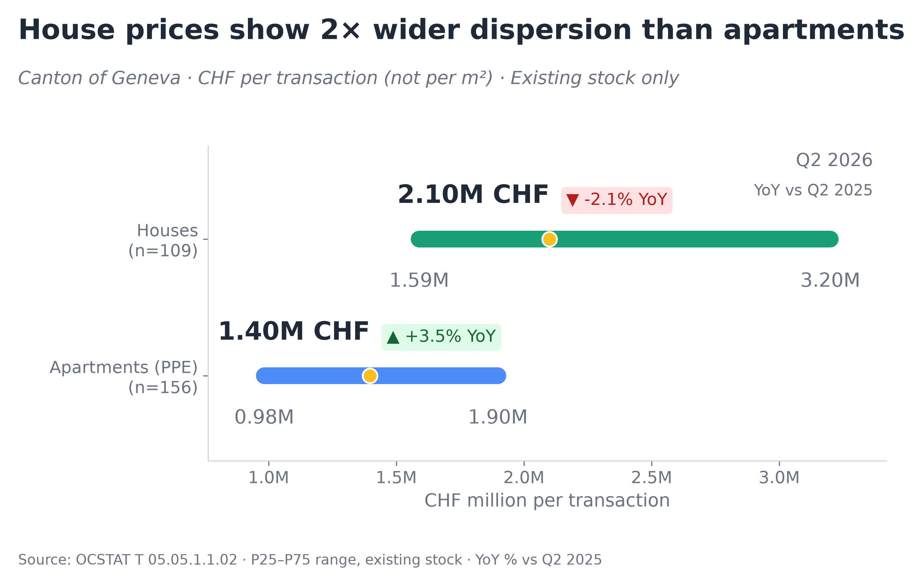
Geneva Canton · Residential Market · Q2 2026
OCSTAT · Canton of Geneva · Quarterly
▸ Existing houses averaged about 2× the transaction value of existing apartments in Q2 2026 (CHF 3.57M vs CHF 1.76M)
▸ The apartment P50–P75 range overlaps with the house P25–P50 range at roughly CHF 1.6–1.9M
▸ All figures are completed notarial transactions (OCSTAT), not listings or appraisals. Left chart: average ticket. Right chart: official OCSTAT medians with P25–P75 range.
Source: OCSTAT T 05.05 · Official notarial transactions, Canton of Geneva · Author’s calculations · Methodology and code: https://github.com/slviktor/geneva-real-estate-market-analysis

Slide 2
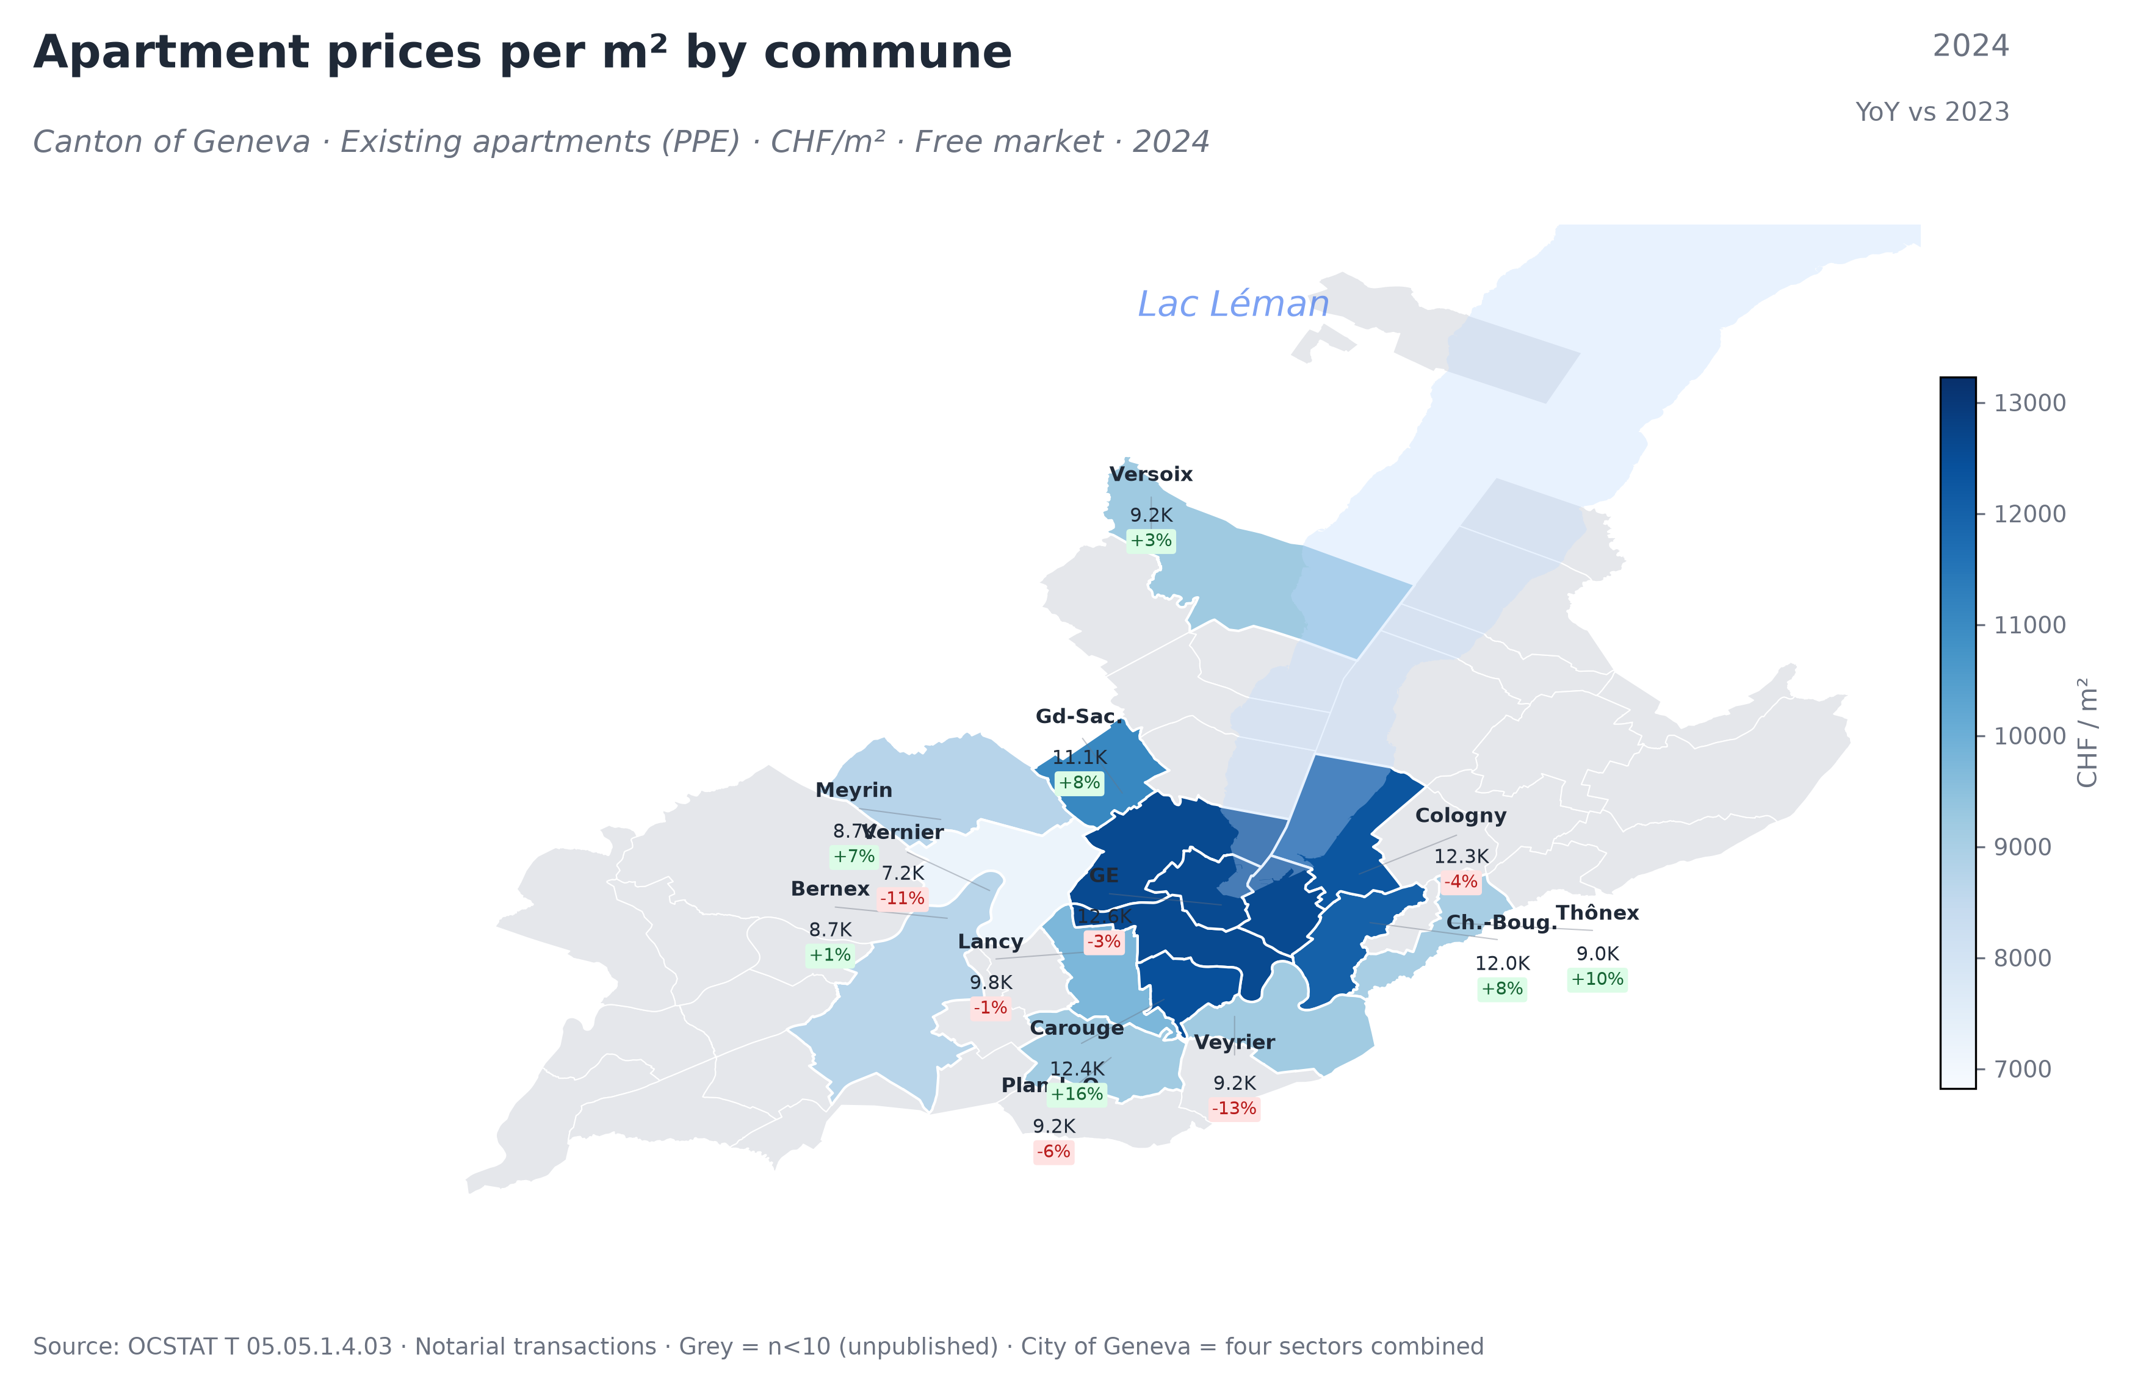
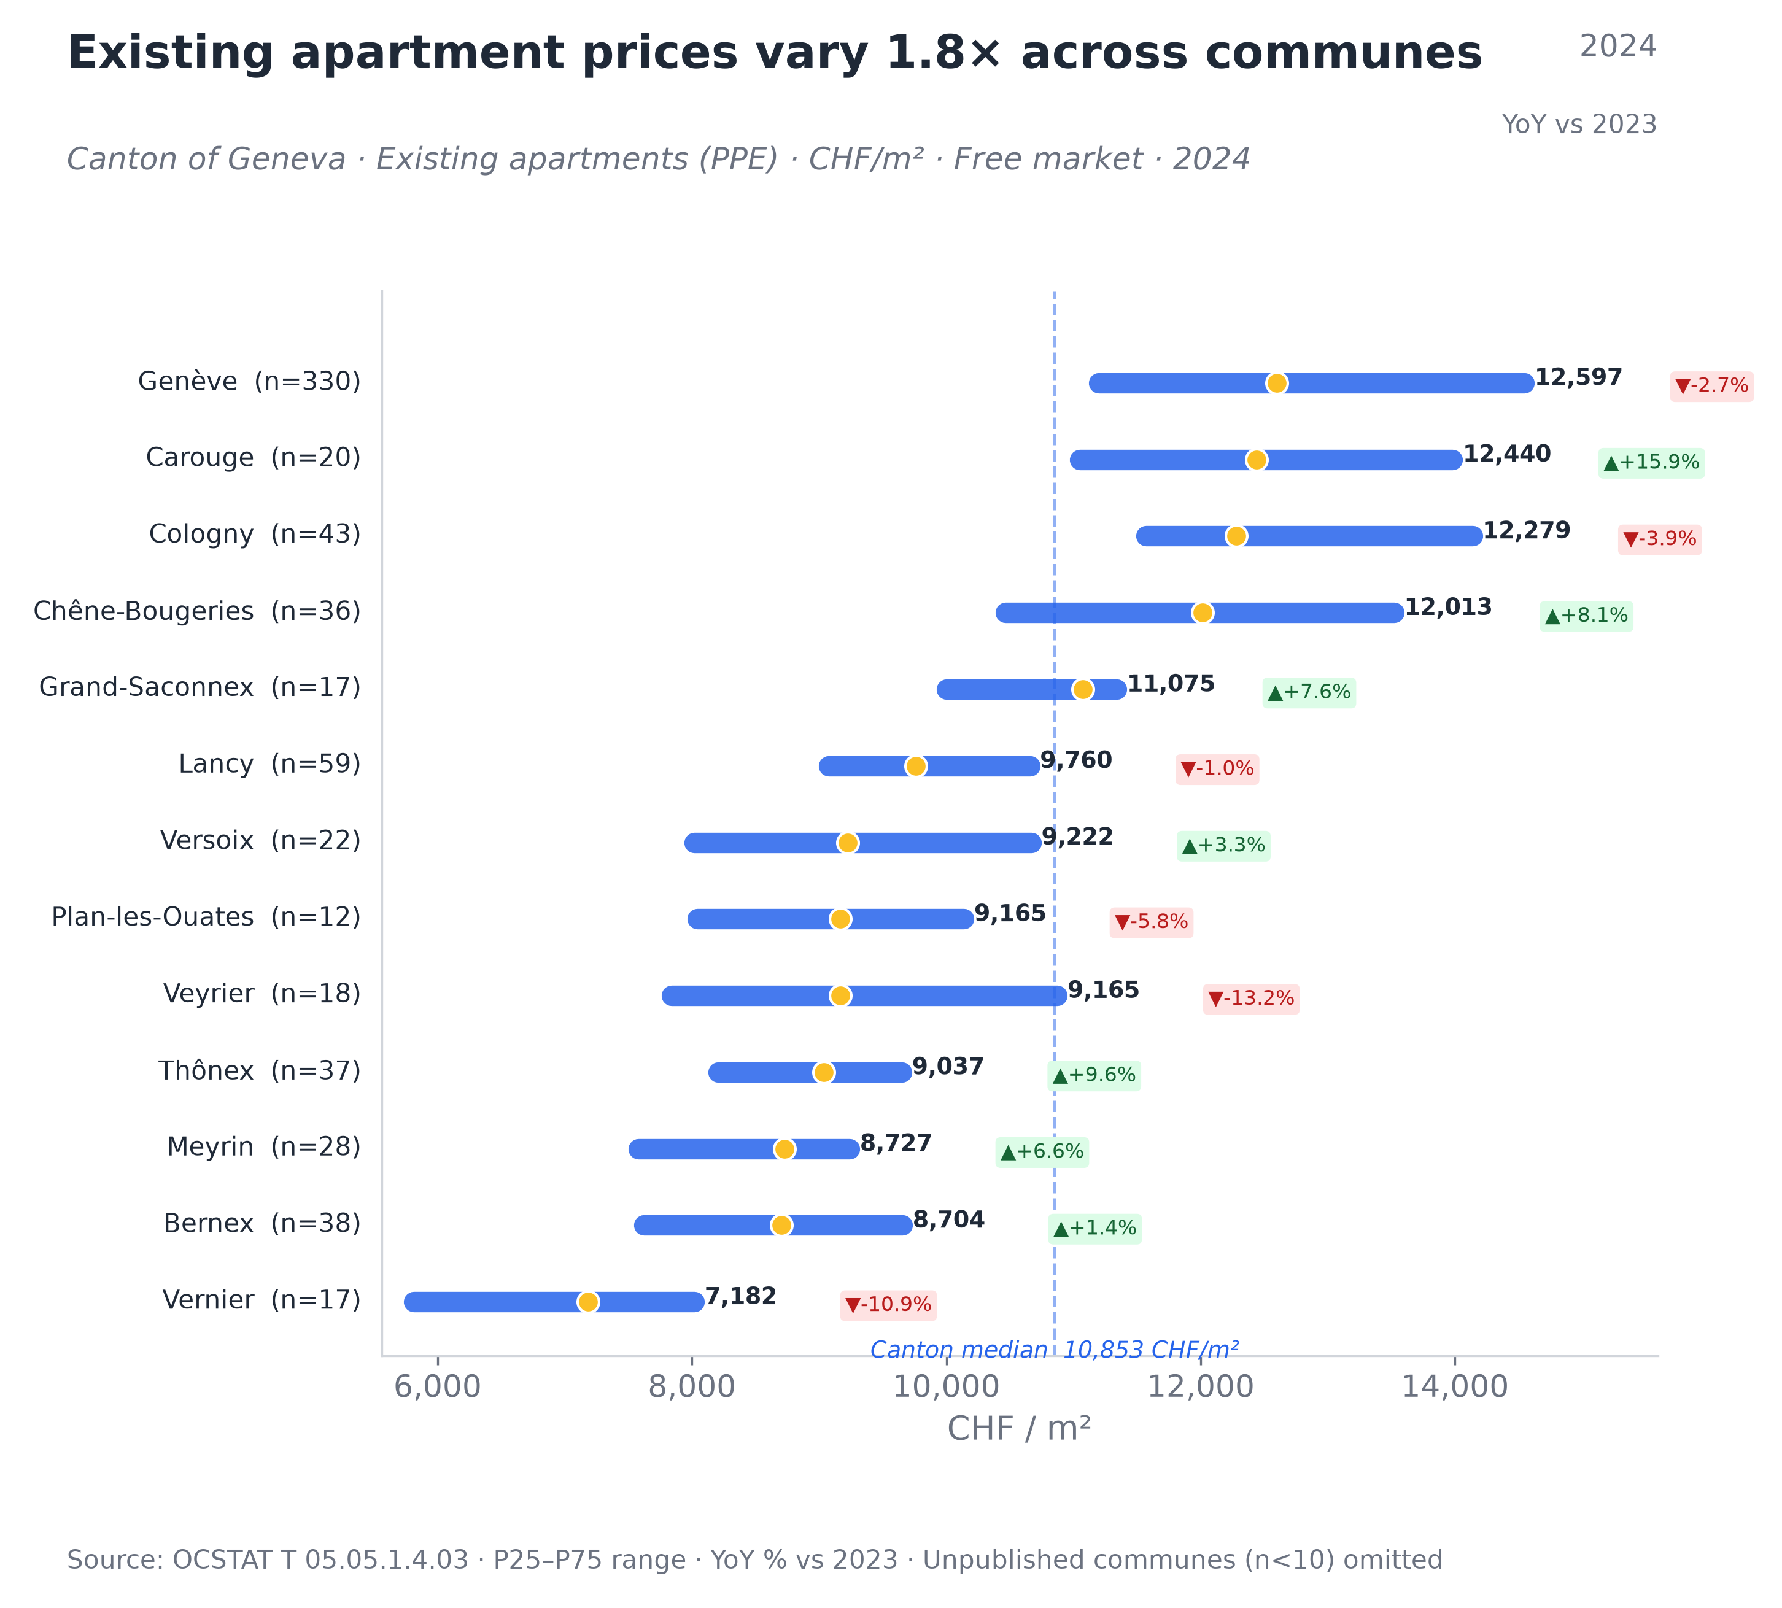
Geography · Where Does It Matter?
OCSTAT · Canton of Geneva · Annual 2024
▸ 1.8× apartment price gap across communes: 7K CHF/m² in Vernier vs 12.5K in Cologny — same 60m² flat costs 430K vs 740K.
▸ Houses even more polarized: Cologny median (6.2M) is 3.7× Vernier (1.7M).
▸ "New is cheaper" is a composition effect — within each commune, new apartments cost 17–29% more (see the full version of the report)
Source: OCSTAT T 05.05 · Official notarial transactions, Canton of Geneva · Author’s calculations · Methodology and code: https://github.com/slviktor/geneva-real-estate-market-analysis

Slide 3
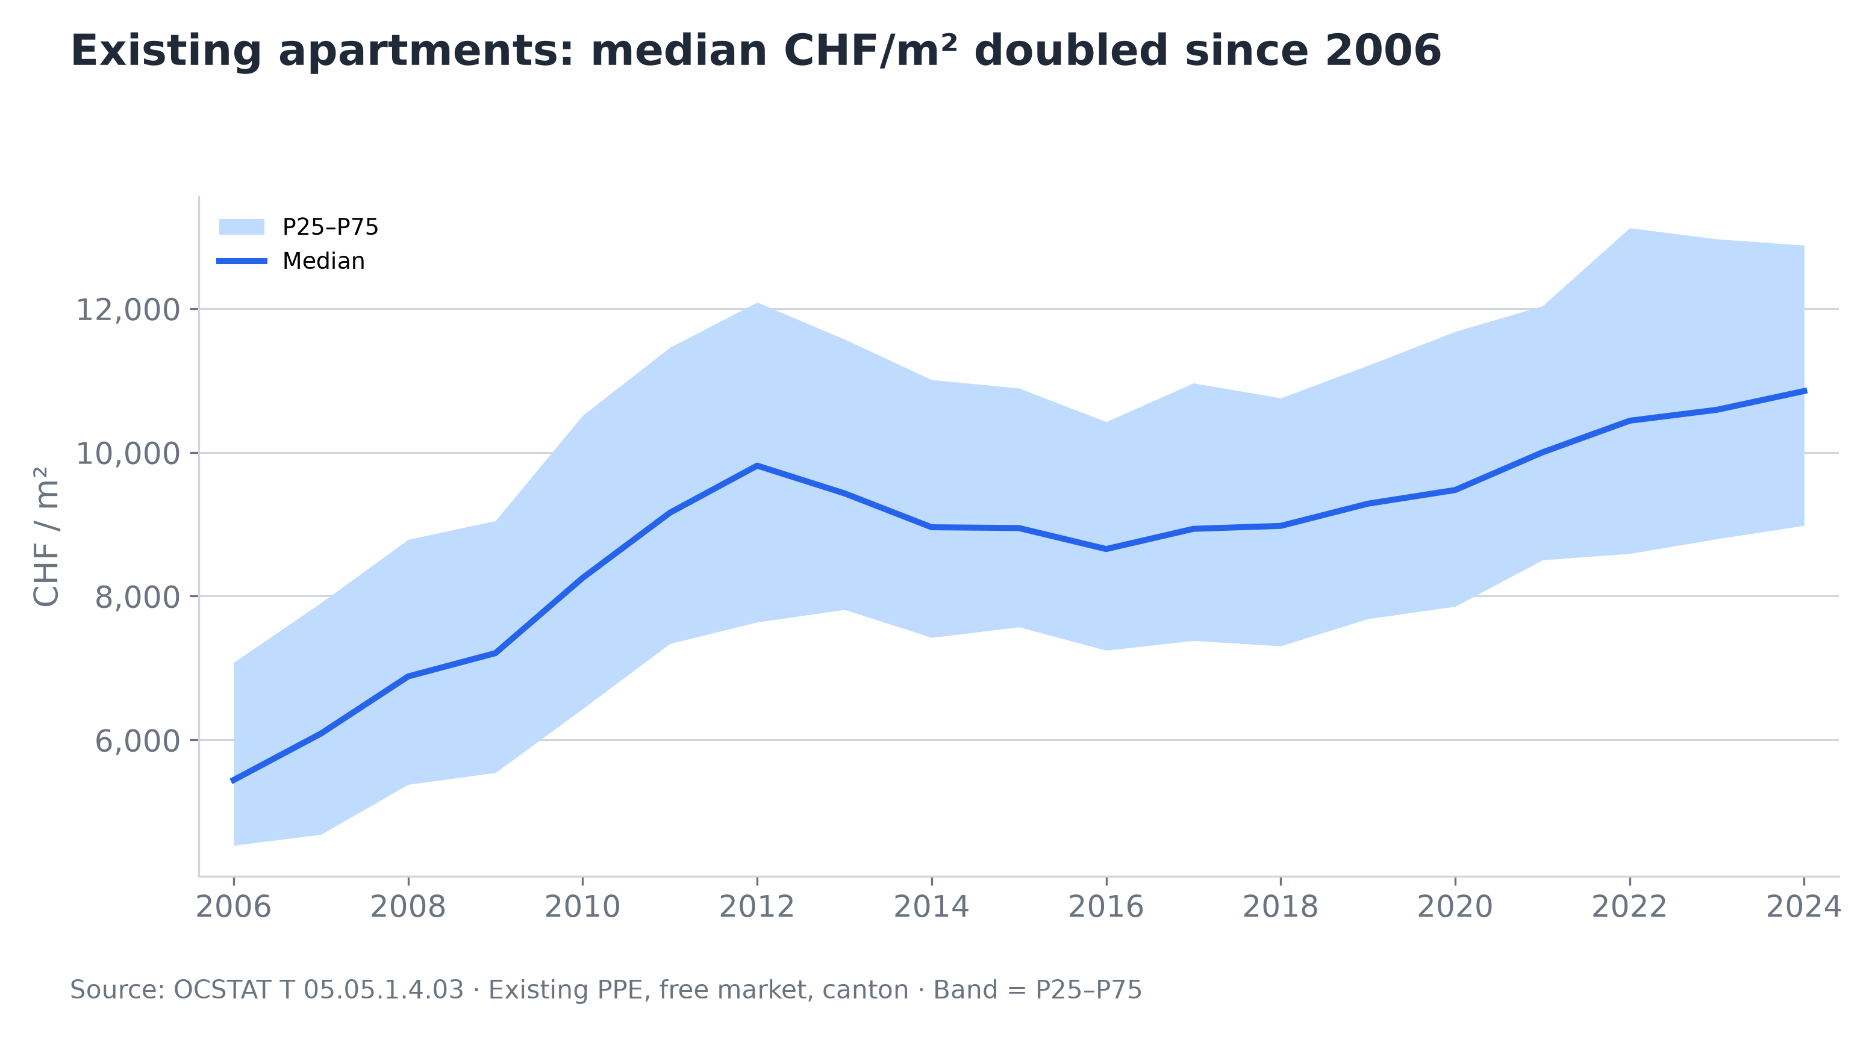
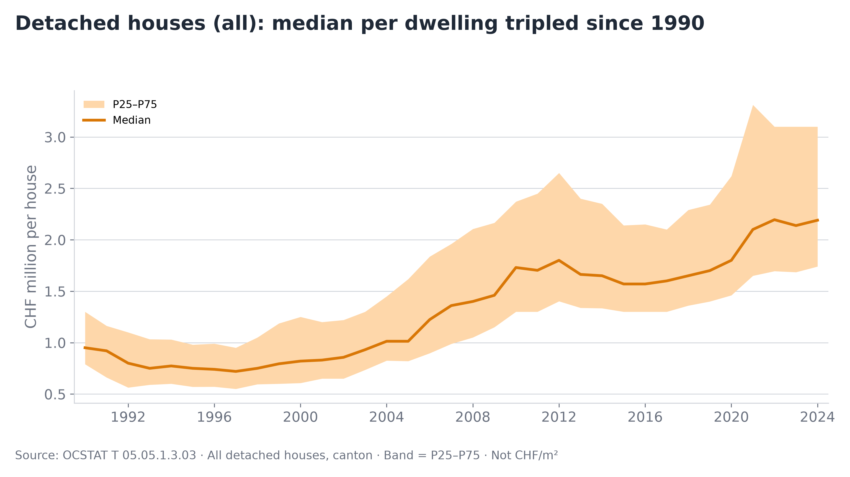
Long-term Trends · How We Got Here
OCSTAT · Canton of Geneva · Annual
▸ Apartments ×2 since 2006, houses ×3 since 1990 — no sustained decline after any correction in either market.
▸ During downturns, P75 drops 2–3× faster than P25 — expensive segment corrects, the floor holds.
▸ Post-2020: house price band widened sharply (premium surge); apartment band stayed stable.
Source & reproducibility
▸ OCSTAT T 05.05 series — completed notarial transactions, Canton of Geneva. Published by the cantonal statistics office.
▸ All charts generated from raw data via Python (pandas, matplotlib). Code and methodology available on GitHub.
Source: OCSTAT T 05.05 · Official notarial transactions, Canton of Geneva · Author’s calculations · Methodology and code: https://github.com/slviktor/geneva-real-estate-market-analysis

